Slide 1

PBCST504 – MICROCONTROLLERS
MICRO PROJECT
Zeroth Review

Slide 2
USB ATTACK DETECTION AND AUTO ISOLATION SYSTEM
Group No: 7
Members:
ABHISHEK TV (JEC24CC002)
AKASH BOBAN (JEC24CC011)
AMRITHA M (JEC24CC017)
MOHAMMED BILAL AT (JEC24CC043)
MS DEVADATHAN (JEC24CC045)
Project Coordinator:
Ms.Sagna L T
Asst. Prof. CSE(CY)

Slide 3
DEPARTMENT OF COMPUTER SCIENCE & ENGINEERING
(Cyber Security)
Vision of the Department
To be a globally recognized centre of excellence in Cyber Security education, research and innovation by nurturing ethical professionals , fostering technological advancement through responsible practice and contributing to a secure and sustainable digital society.

Slide 4
DEPARTMENT OF COMPUTER SCIENCE & ENGINEERING
(Cyber Security)
Mission of the Department
M1: Excellence in Education : To provide outcome-based and industry-oriented education by integrating core computer science principles with advanced cybersecurity technologies and practices.
M2: Ethics and Professional Responsibility : To cultivate ethical values, integrity, social responsibility, and secure computing practices for protecting digital assets and strengthening cyber trust.
M3: Research, Innovation, and Entrepreneurship : To promote research, innovation, and entrepreneurial thinking for developing sustainable solutions to emerging cybersecurity challenges.
M4: Holistic and Global Development : To enhance leadership, teamwork, lifelong learning, and global competence through industry collaboration, interdisciplinary activities, and community engagement.

Slide 5
Programme Educational Objectives (PEOs)
PEO 1: Graduates will apply strong foundations in computer science and cybersecurity to design, develop, and manage secure and reliable computing systems for industry and society.
PEO 2: Graduates will pursue successful careers as professionals, innovators or entrepreneurs engaged in technology development, deployment or engineering system implementation in industry and society and contribute to the economic growth of the country.
PEO 3: Graduates will demonstrate ethical responsibility, leadership, teamwork, and effective communication while adapting to evolving global technological environments through lifelong learning.

Slide 6
Programme Outcomes
Engineering Graduates will be able to:
1. Engineering knowledge: Apply the knowledge of mathematics, science, engineering fundamentals, and an engineering specialization to the solution of complex engineering problems.
2. Problem analysis: Identify, formulate, review research literature, and analyze complex engineering problems reaching substantiated conclusions using first principles of mathematics, natural sciences, and engineering sciences.
3. Design/development of solutions: Design solutions for complex engineering problems and design system components or processes that meet the specified needs with appropriate consideration for the public health and safety, and the cultural, societal, and environmental considerations.
4. Conduct investigations of complex problems: Use research-based knowledge and research methods including design of experiments, analysis and interpretation of data, and synthesis of the information to provide valid conclusions.
5. Modern tool usage: Create, select, and apply appropriate techniques, resources, and modern engineering and IT tools including prediction and modeling to complex engineering activities with an understanding of the limitations.

Slide 7
6. The engineer and society: Apply reasoning informed by the contextual knowledge to assess societal, health, safety, legal and cultural issues and the consequent responsibilities relevant to the professional engineering practice.
7. Environment and sustainability: Understand the impact of the professional engineering solutions in societal and environmental contexts, and demonstrate the knowledge of, and need for sustainable development.
8. Ethics: Apply ethical principles and commit to professional ethics and responsibilities and norms of the engineering practice.
9. Individual and team work: Function effectively as an individual, and as a member or leader in diverse teams, and in multidisciplinary settings.
10. Communication: Communicate effectively on complex engineering activities with the engineering community and with society at large, such as, being able to comprehend and write effective reports and design documentation, make effective presentations, and give and receive clear instructions.
11. Project management and finance: Demonstrate knowledge and understanding of the engineering and management principles and apply these to one’s own work, as a member and leader in a team, to manage projects and in multidisciplinary environments. 12. Life-long learning: Recognize the need for, and have the preparation and ability to engage in independent and life-long learning in the broadest context of technological change.

Slide 8
Programme Specific Outcomes (PSOs)
On the completion of Computer Science & Engineering program, the students will possess:
PSO 1: Apply cyber security principles to mitigate cyber risk and analyze security requirements of an organization.
PSO 2: Develop and deploy secure software and infrastructure using modern tools and industry standards.
PSO 3: Uphold ethical, legal, and societal responsibilities while protecting privacy, data, and digital assets.

Slide 9
CONTENTS
Motivation
Introduction
Problem Statement
Proposed Method
Basic Block Diagram
Conclusion
References

Slide 10
Motivation
Hardware-Level Exploits: Malicious USB devices (e.g., BadUSB, Rubber Ducky) impersonate legitimate Human Interface Devices (HID) to bypass traditional software firewalls and antivirus protections.
Rapid Attack Vectors: Automated keystroke injection attacks execute payloads within seconds of insertion, leaving human operators no time to react.
Critical System Vulnerabilities: Air-gapped and industrial systems often rely on physical USB ports, making hardware-level USB threats a major breach vector.
Proactive Defense Need: Requirement for an automated, hardware-interfaced micro-controller solution that detects anomalous USB behavior and physically/logically isolates the threat instantly.

Slide 11
Introduction
Concept: The USB Device Attack Detection and Auto Isolation System is a microcontroller-based hardware security mechanism designed to monitor USB traffic and power patterns.
Key Objective: To protect end-user operating systems and critical infrastructure from rogue USB hardware attacks.
Core Mechanisms:
Real-time monitoring of HID activity (keystroke frequency, payload signatures, power draw).
Automated physical cut-off (using relays/MOSFETs) or host-level driver disabling upon detecting malicious profiles.
Microcontroller Role: Serves as an intermediary host/bridge (e.g., STM32/ESP32/Raspberry Pi Pico) that inspects device descriptors before exposing them to the target machine.

Slide 12
Problem Statement
Traditional host operating systems automatically trust hardware components identified as USB Human Interface Devices (HID). Attackers exploit this trust using microcontrollers programmed to mimic keyboards/mice, injecting malicious command scripts (e.g., PowerShell commands, reverse shells) faster than human capability.
Existing Limitations:
Software antivirus fails to block rogue keyboards because keystrokes appear as valid user input.
Manual unplugging by the user is ineffective due to the high execution speed of payload scripts.

Slide 13
Proposed Method
Intermediate Inline Inspection: Place a hardware shield/microcontroller inline between the USB device and the target host system.
Anomalous Behavior Detection:
Analyze typing speed (e.g., >100 WPM anomaly threshold).
Monitor power profiles for USB Killer-type electrical overstress attacks.
Auto-Isolation Mechanism:
Trigger an immediate hardware disconnect via power/data line switching components (Relay/MOSFET) upon detection.
Send visual/audible alert signals (LED/Buzzer) to notify system administrators.

Slide 14
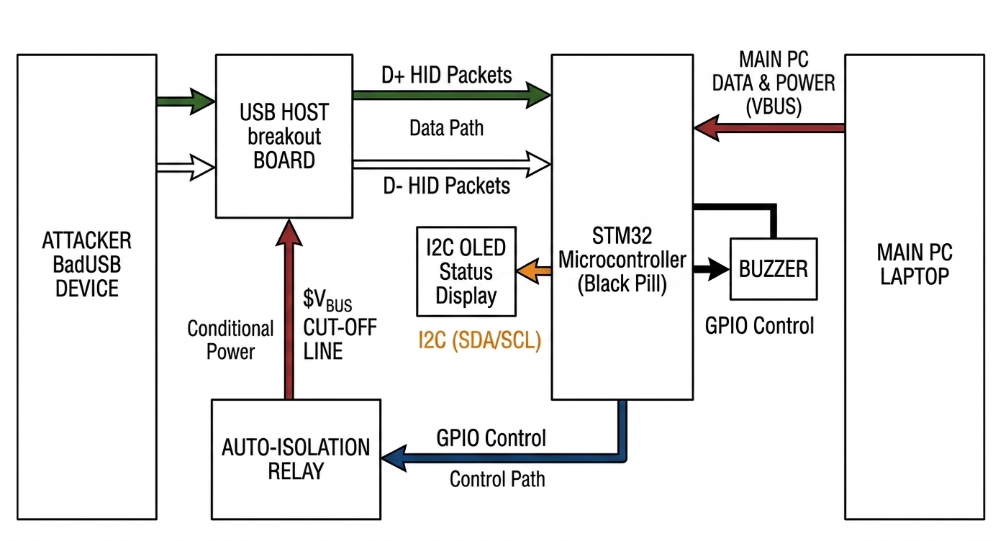
Basic Block Diagram

Slide 15
Conclusion
The proposed USB Device Attack Detection and Auto Isolation System bridges the gap between hardware trust and software security.
Provides a real-time, low-latency defense mechanism against keystroke injection and rogue USB hardware attacks.
Safeguards critical machines without relying on vulnerable host OS security layers.
Future Scope: Integrating machine learning algorithms on edge microcontrollers to detect zero-day USB behavior anomalies.

Slide 16
References
1) K. Nohl, S. Krißler, and J. Lell, "BadUSB – On accessories that turn evil," in Black Hat USA, Las Vegas, NV, 2014.
2) USB Implementers Forum, "Device Class Definition for Human Interface Devices (HID)," Specification Version 1.11.
3) D. Kitchen, "USB Rubber Ducky: Keystroke Injection & Hardware Attack Vectors," Hak5 Security Research, 2022.
4) C. Doctorow, "USG: Open-Source Hardware USB Firewall," Embedded Hardware Security Review, 2017.

